Slide 1
A Comparative Analysis of Different Modelling Paradigms for Real-Time Digital Twin Development
White-Box vs Black-Box Modelling
Student: Kelvin Mafurendi
Student Number: 220702330
Supervisor: Dr. K. Reddy
Module: ERDP402 Project
Date: 31 July 2025

Slide 2
Modelling Paradigms & Project Objective
Digital Twin Application
Predictive maintenance & failure prevention
Real-time performance monitoring
Process optimization & efficiency gains
Reduced unplanned downtime costs
Virtual testing without physical risks
White-Box Modelling
Physics-based analytical models
Built from first principles
Transparent internal structure
Requires deep system knowledge
High accuracy for known physics
Black-Box Modelling
Data-driven system identification
Based on Input-output relationships
Internal structure unknown
Requires historical data
Adaptable to complex behaviours
Project Objective
Investigate which modelling paradigm is most suitable for efficient digital twin development by comparing white-box and black-box approaches using a 3-phase induction machine as the test case.

Slide 3
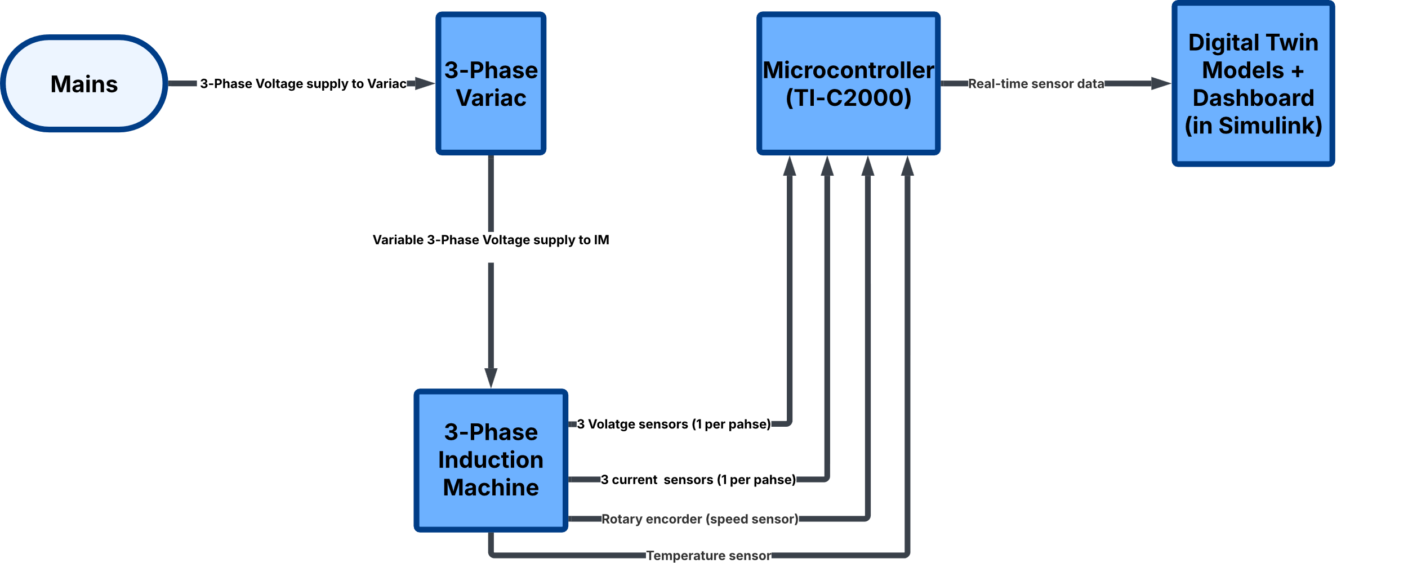
Experimental Setup & Validation Criteria
Accuracy
Real-time Performance
Development Complexity
Compare steady-state performance and transient response accuracy against physical system
Evaluate data update handling speed and computational efficiency
Assess resource requirements and time investment for model creation

Slide 4
Thank You!

